Slide 1

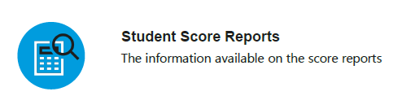
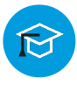

PSAT Scores
What You’ll Learn
Student Score Reports
Information available on score reports
PSAT/NMSQT Scores
What those scores mean
Resources for students
Discover resources available through
the PSAT / NMSQT

Slide 2
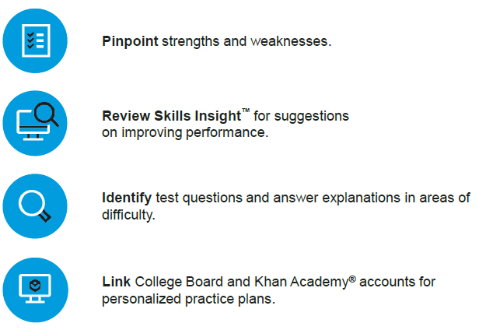


Pinpoint strengths and weaknesses.
Review Skills Insight for suggestions
on improving performance.
Identify test questions and answer explanations in areas of difficulty.
Link College Board and Khan Academy accounts for personalized practice plans.
Understanding Your PSAT/NMSQT Score Report - VIDEO

Slide 3
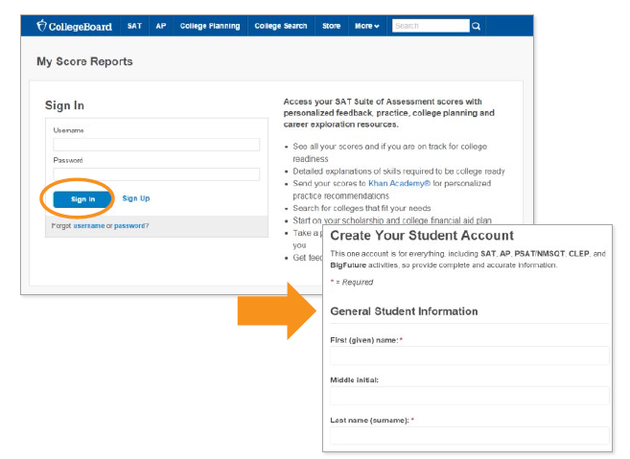

Log in to an existing College Board account
or create a new one at:
studentscores.collegeboard.org

Slide 4
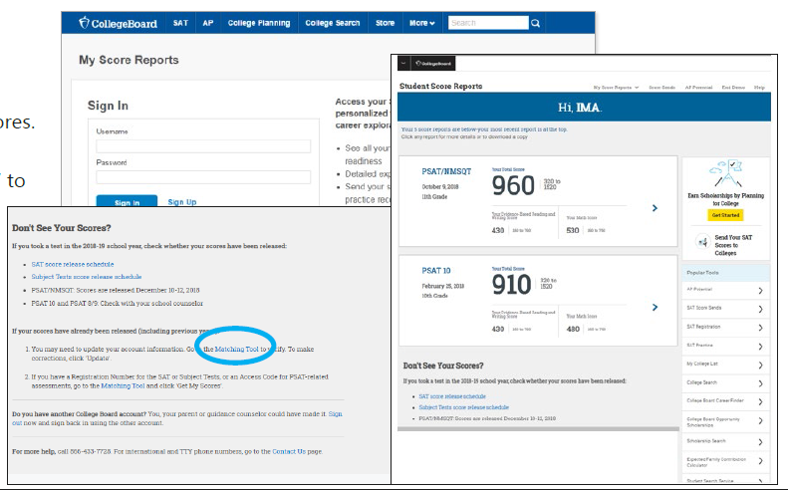
Log in to your College Board account.
Select PSAT/NMSQT Scores
*OR* Use the “Matching Tool” to locate.

Slide 5
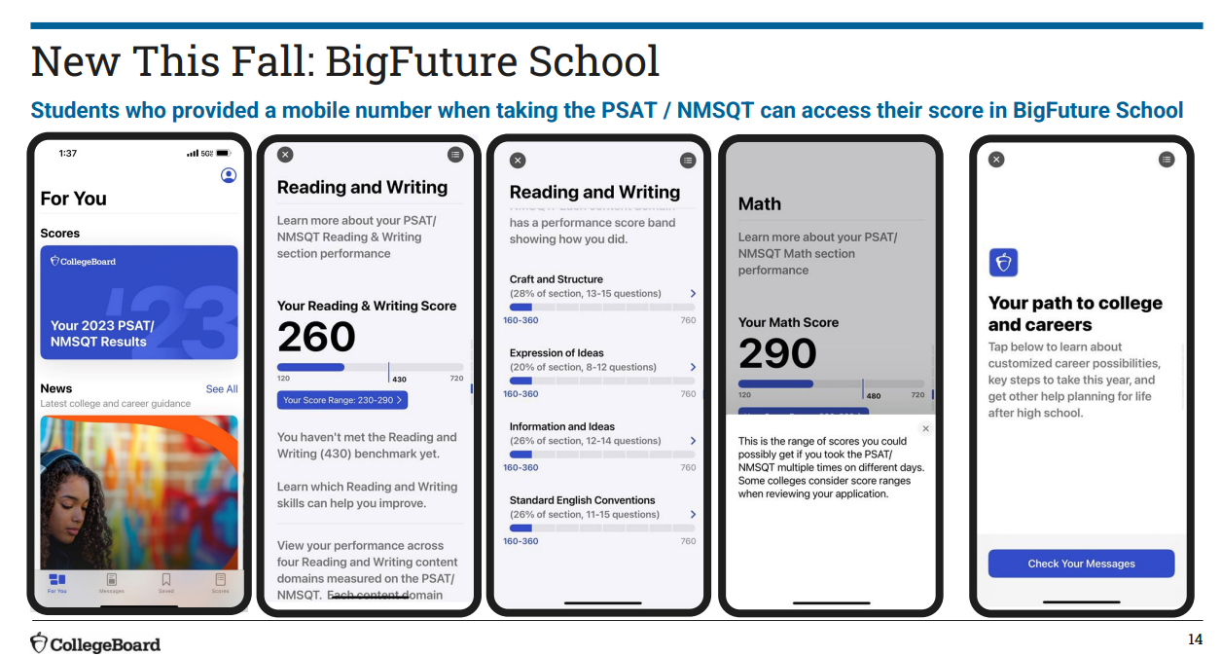
Download BigFuture School Mobile App
https://satsuite.org/k12bigfutureschool

Slide 6
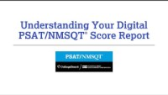

Slide 7
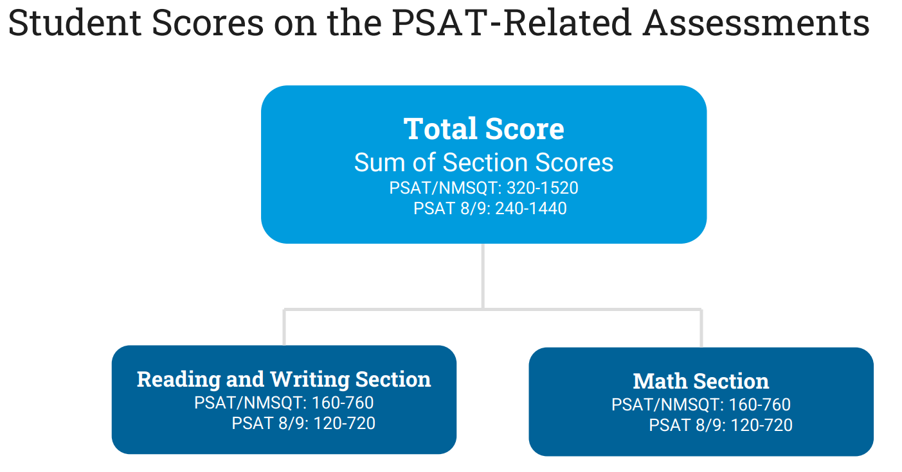


Slide 8
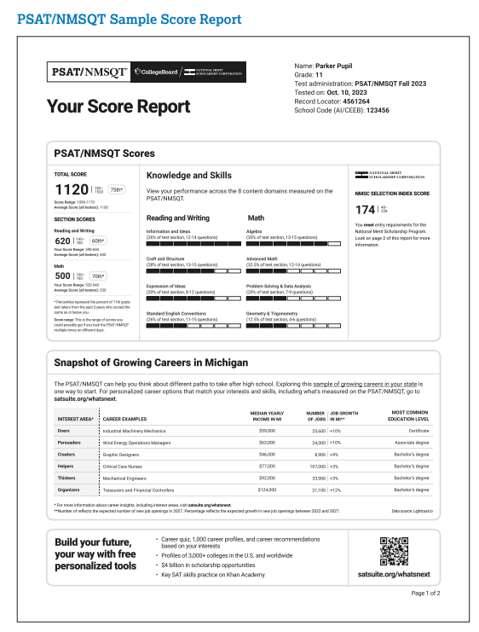
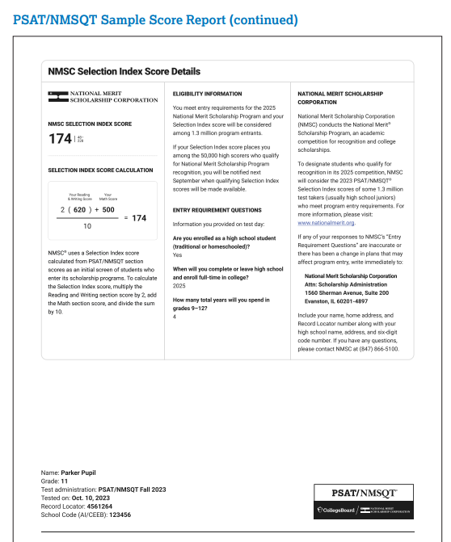

Slide 9
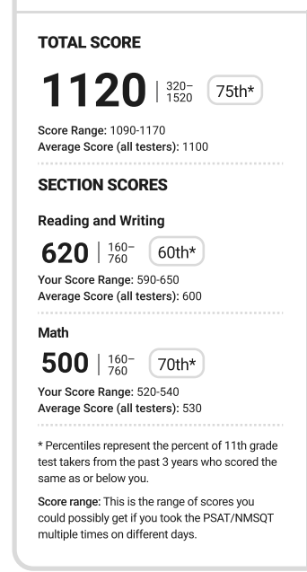
Percentile score.
Example: 75th percentile means score was same or higher than 75% of other students.
Your score is scaled to represent what you would score if taking SAT exam.
Subscores

Slide 10
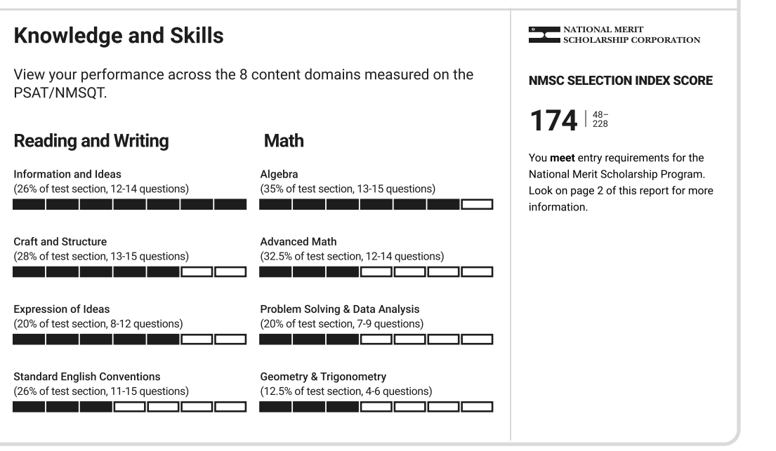
Percentiles.
Shows percentage of the section each content area represents.
Representation of performance. Shows areas of strengths and weaknesses.
Subscores
If you have a star next to number, You DO NOT meet entry requirements to NMSC.

Slide 11
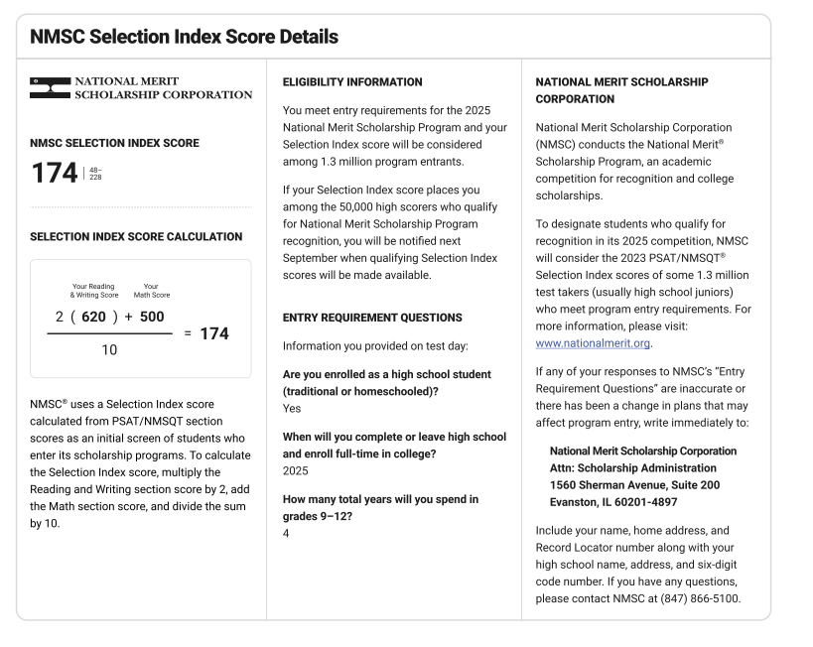

Slide 12
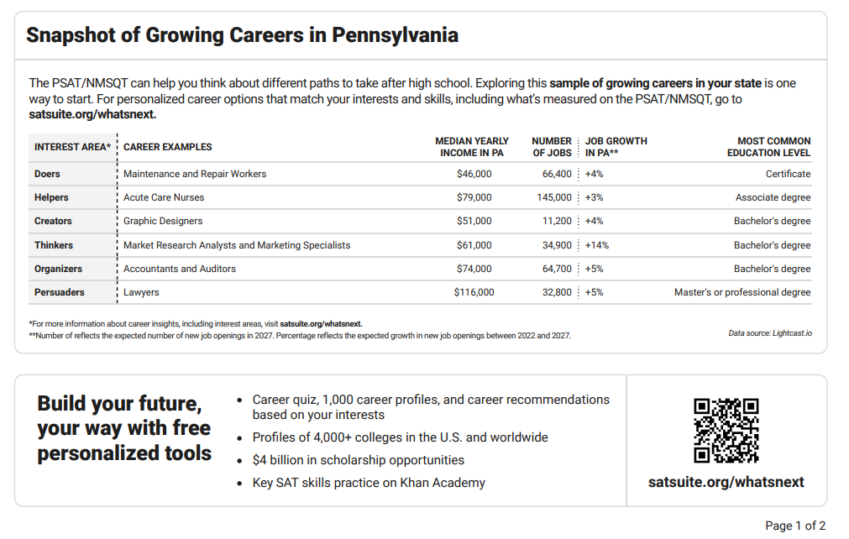
More personalized features!

Slide 13
Paper Score Report
Paper Score Reports are no longer mailed by CollegeBoard.org but can always be downloaded and printed from your account.
** Please reach out to your counselor if you would like a printed copy.

Slide 14
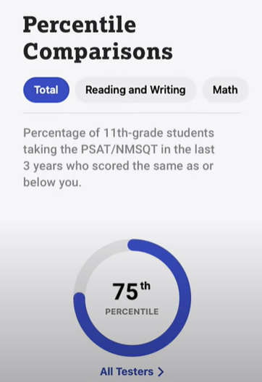
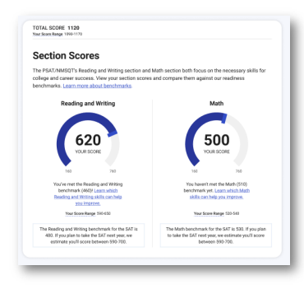
Other Features Provided

Slide 15
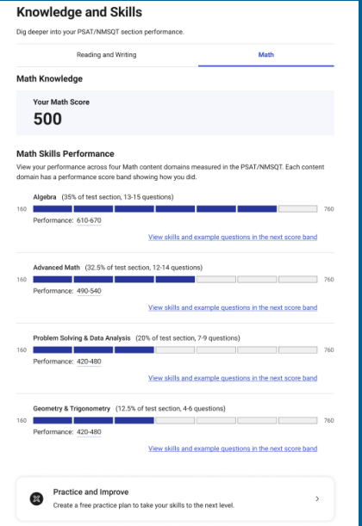
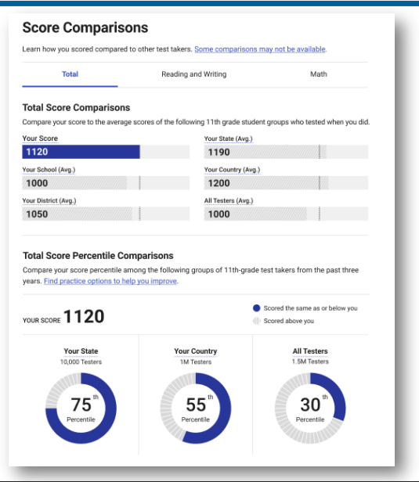
Other Features Provided
Skills and example questions. Answer explanations included.
More detailed benchmarks

Slide 16
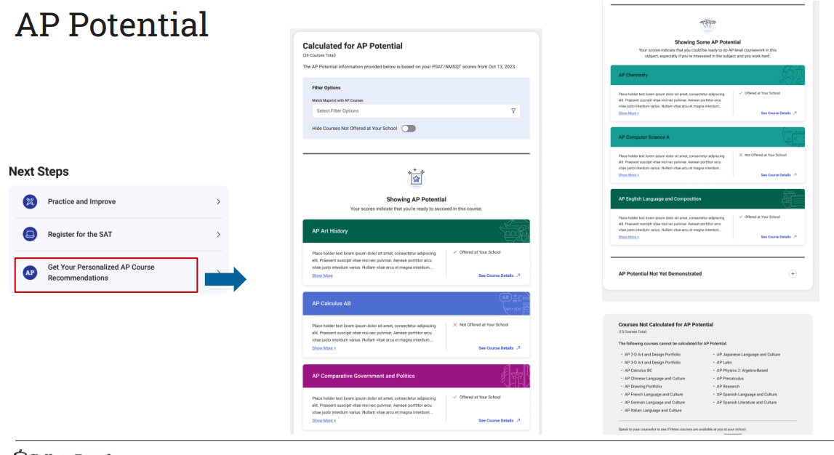
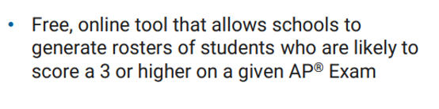
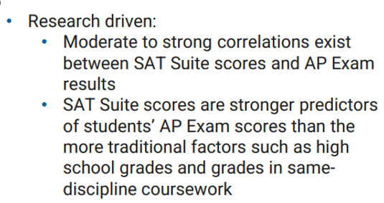
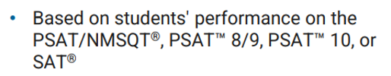

Slide 17
Next Steps for Students and Parents
View a video-walk through of the score report: https://satsuite.collegeboard.org/psat-nmsqt/scores/understanding-scores/your-score-explained
Learn more about understanding and using scores: psat.org/scores
Connect to Scholarships: collegeboard.org/sat-suite-scholarships
Practice for the SAT: sat.org/digital-practice

Slide 18
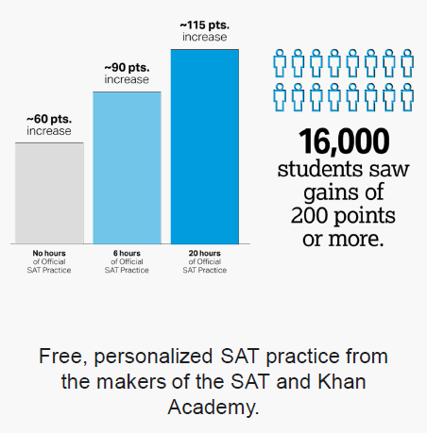
SAT Practice on KHAN ACADEMY
6-8 hours of practice for the SAT on Khan Academy is associated with an average 90-point increase from the PSAT to the SAT.
Link College Board and Khan Academy accounts to access personalized practice plan.

Slide 19
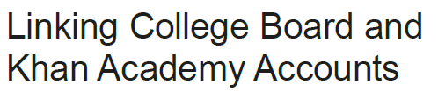
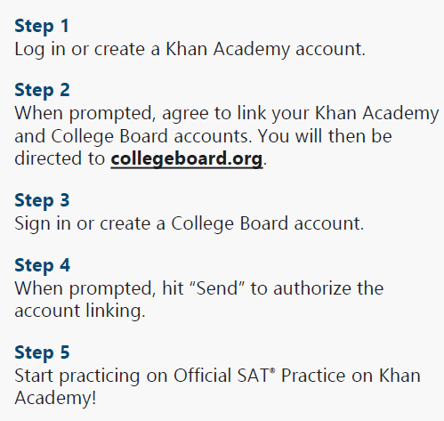
**On iPad**
My stuff-> Courses->
Test Prep-> SAT -> Select that you’ve taken it -> Sign-in to CollegeBoard ->
Send -> allow

Slide 20
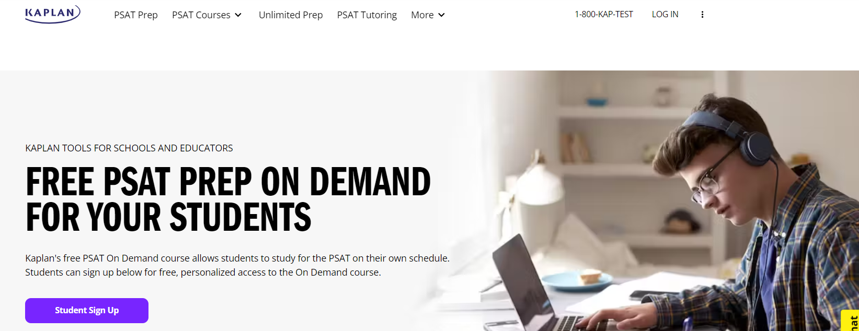
KAPLAN Free PSAT Courses
https://www.kaptest.com/psat/courses/partner/psat-prep-on-demand

Slide 21
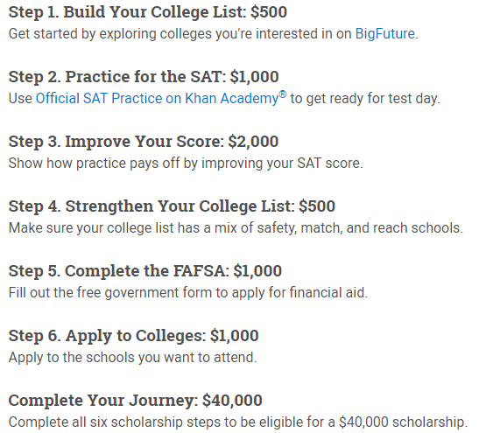
College Board Opportunity Scholarships
How it works:
Completing steps qualifies you for a scholarship ranging from $500 - $2,000.
Completing all 6 steps possibly qualifies you for a $40,000 scholarship.
Winners notified by email and “My Achievements” page when logging in to College Board Opportunity Scholarships.
cb.org/opportunity

Slide 22

College Board National Recognition Programs
Benefits
Academic honors that can be included on college or scholarship applications.
Colleges use it to identify academically exceptional students who have
excelled on their PSAT/NMSQT, PSAT 10, or AP Exams and in their classrooms.
Who’s Invited to Apply:
Students who take the PSAT/NMSQT in October of their junior year and
score in the top 10% by state OR earn score of 3 or higher on two or
more AP exams by junior year.
GPA Criteria: 3.5 or higher.
Program Criteria: Are African American, Hispanic American or Latinx,
Indigenous or live in a rural area.
Application window based on Oct.2021 PSAT scores: Spring 2022.
Visit psat.org/recognition for more information.

Slide 23
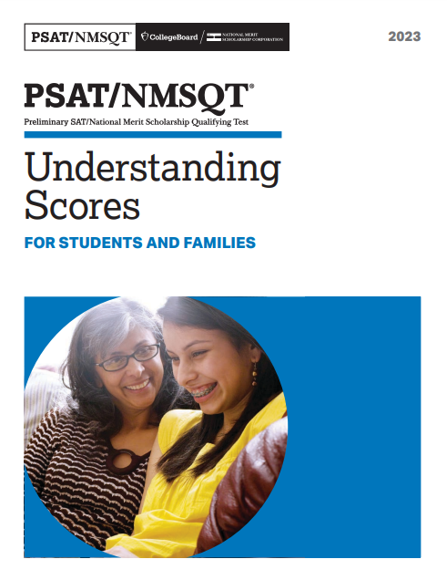
CLICK HERE FOR ELECTRONIC GUIDE

Slide 24
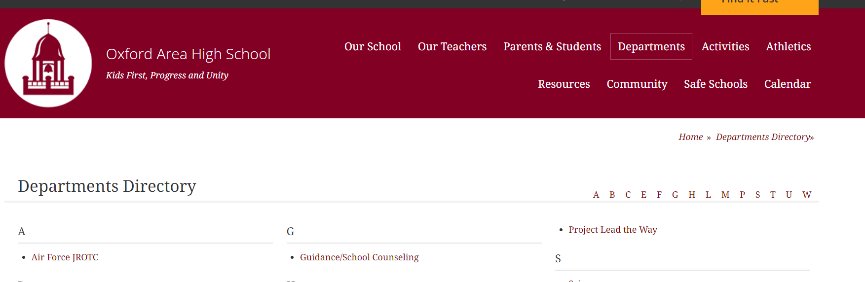
Oxford Area H.S. – Guidance Dept. Website –> PSAT Information Page
https://www.oxfordasd.org/Page/2163

Slide 25
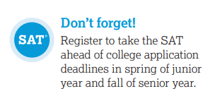
Questions?
email Ms. Cintora at
scintora@oxfordasd.org

