Slide 1

What you need to know about the digital SAT Suite of Assessments
Notes:
Note for educators: Please update this slide with the date you will be delivering this presentation.​
Script template:​
Welcome! Thank you all for joining us today. We’re excited to talk to you about the SAT Suite of Assessments and to share with you some positive changes to the tests that will benefit your children. ​

Slide 2

The Transition to Digital Testing
Notes:
Script template:​
As you may have heard, the SAT and the rest of the suite are moving from their current paper and pencil format to a new digital format.​

Slide 3
Transition to Digital
The SAT Suite of Assessments is transitioning from paper and pencil to a digital format.
Fall 2023
Spring 2024
PSAT 8/9
PSAT 10
N/A
®®/NMSQT
N/A
SAT (U.S. Weekend and School Day)
Digital
Paper and pencil
Notes:
Note for educators: Please delete the portion of the graphic with any assessment not offered by your school during the 2023-24 school year.​​
Script template:​
Beginning this fall, the PSAT 8/9 and PSAT/NMSQT will be the first part of the SAT Suite to transition to digital in the U.S. The SAT will remain in its current paper and pencil format for this fall but will transition to the new digital format next spring, along with the PSAT 10.​
​
By giving our juniors the opportunity to take the digital PSAT/NMSQT this fall, we're allowing them a chance to become more familiar with the testing format before taking the digital SAT next spring.

Slide 4

PSAT/NMSQT
Notes:
Note for educators: Please delete all slides in this section if you’re not offering the PSAT/NMSQT during the 2023-24 school year. ​
Script template:​
This fall we’ll offer the Preliminary SAT/National Merit Scholarship Qualifying Test, also referred to as the PSAT/NMSQT.​

Slide 5
PSAT/NMSQT
Structured similarly to the SAT, the PSAT/NMSQT (Preliminary SAT/National Merit Scholarship Qualifying Test) is given to 10th- or 11th-grade students and measures the same knowledge and skills students need to succeed in college and career.
The test is designed to help prepare students for the SAT, college, and careers. Historically, students who took the PSAT/NMSQT scored higher on the SAT, on average, than those who didn’t take the test.
Learn more at
https://satsuite.collegeboard.org/psat-nmsqt
Notes:
Note to educators: Please update this slide and the speaker notes to reflect the grade level taking the PSAT/NMSQT.​
Script template:​
The PSAT/NMSQT is offered to our [insert grade level] students and is designed to help prepare them for the SAT, college, and careers. And what’s great is students who take the PSAT/NMSQT score higher on the SAT, on average, than those who don’t take the test. By giving your child the opportunity to take the PSAT/NMSQT we’re giving them an opportunity to do their very best if they choose to take the SAT.​

Slide 6
Get More from
Their Score
While the PSAT/NMSQT is great practice for the SAT,
there’s so much more to be gained from their score.
Notes:
Script template:​
While the PSAT/NMSQT is great practice for the SAT, there’s so much more to be gained from their score.​
​

Slide 7
PSAT/NMSQT
See Where They Are and Set a Target
Your child will receive insights about their knowledge and skills while they still have plenty of time to improve.
If they’ve taken the PSAT 8/9 or PSAT 10 they’ll be able to see the progress they’ve made.
Taking the PSAT/NMSQT will help your child set an SAT target score that aligns with their college or career goals.
Notes:
Note to educators: Revise or remove the second bullet and the speaker notes to represent only the assessments you offer.​
Script template:​
Similar to the PSAT 8/9 and PSAT 10, your child will receive valuable insights about their knowledge and skills and their areas of strength and areas to improve. And, if they’ve taken the PSAT 8/9 or PSAT 10, they’ll be able to compare their performance to see the progress they’ve made. ​
​
This information will help your child set their target score for the SAT in a way that aligns with their college or career goals.​

Slide 8
PSAT/NMSQT
National Merit Scholarship Program
Students who take the PSAT/NMSQT in 11th grade and meet other program entry requirements might qualify for the National Merit® Scholarship Program, an academic competition for recognition and scholarships conducted by the National Merit Scholarship Corporation (NMSC®).
The PSAT/NMSQT is the only qualifying test for the National Merit Scholarship Program.
Notes:
Script template:​
Students who take the PSAT/NMSQT in 11th grade and meet other program entry requirements might qualify for the National Merit Scholarship Program, an academic competition for recognition and scholarships conducted by the National Merit Scholarship Corporation (NMSC®).​
​
The PSAT/NMSQT is the only qualifying test for the National Merit Scholarship Program. ​
​

Slide 9
PSAT/NMSQT
Help Pay for College
Taking the PSAT/NMSQT gives your child the chance to access over $300 million in scholarship opportunities.
Students may also qualify for College Board National Recognition Programs.
Learn more at psat.org/recognition
Notes:
Script template:​
If your child is planning to go to college, taking the PSAT/NMSQT can help them access over $300 million dollars in scholarship opportunities as well as the chance to qualify for the College Board National Recognition Programs. I encourage you to learn more at psat.org/recognition.​

Slide 10
PSAT/NMSQT
Find Out About Their AP Potential
Your child may not realize they have the potential to succeed in college-level courses.
Using their personalized score report, students will get recommendations about what AP courses might be a good fit for them.
Learn more at:
APstudents.org/course-recommendations
Notes:
Script template:​
In addition to providing access to scholarship and recognition opportunities, the score report also provides your child with recommendations about AP courses we offer that might be a good fit for them.​
​

Slide 11
PSAT/NMSQT
Explore College and Career Options in BigFuture School
BigFuture School™ is a new mobile app for students (13+) who take certain College Board assessments in school.
It’s designed to spark their interest about planning for their future the moment scores are available.
Students can use the app to access their PSAT/NMSQT scores directly on their phone, along with:
  Customized career information and guidance about planning and paying for college.
  Connections™—a feature exclusively for school day test takers that allows them to hear from nonprofit colleges and scholarship programs that may be a good match, without sharing any personal information.
Students should start on the app and then go to BigFuture.org for deeper exploration.
Notes:
Note to educators: Please remove information about Connections if your school or district has opted out of providing access.​
Script template:​​
​BigFuture School is a new mobile app available for students 13 and older who take certain College Board assessments in schools. It's designed to spark their interest in planning for their future.​
​
Students can use the app to access their PSAT/NMSQT scores directly on their phone and can also access customized career information and guidance about planning and paying for college.​
​
In addition, through the Connections feature in the app and without sharing and personal information, students can hear directly from nonprofit colleges and scholarship programs that may be a good match for them.

Slide 12
PSAT/NMSQT
Accessing Score Reports
There are several ways your child can access their scores.
BigFuture School Mobile App: If your child chooses to provide a mobile number during the testing experience, they’ll receive a text message with information about accessing BigFuture School along with their scores. Their mobile number won’t be used for any other purpose.
Personal College Board Account: If they have a personal College Board account, your child can go to studentscores.collegeboard.org for more insights about their scores and next steps.
[School-specific information about PDF score report]
Notes:
Note for educators: Please modify this slide and the speaker notes to reflect how you will deliver scores to students.​
Script template:​
Scores for the PSAT/NMSQT will be available in mid-November. Your child will have three ways to access their scores. ​
​
The first way is through the BigFuture School mobile app. All they need to do is provide their mobile number during the testing experience and they’ll receive a text message with information about accessing the app along with their scores. Their mobile number won’t be used for any other purpose. ​
​
They can also access their scores through their personal College Board account. If they don’t have one, they can go to studentscores.collegeboard.org to set one up.​
​
In addition, we’ll provide your child with a PDF version of their score report. ​
​

Slide 13

Digital PSAT/NMSQT:
What to Expect
Notes:
Script template:​
Here’s what your child can expect when they take the digital PSAT/NMSQT.​

Slide 14
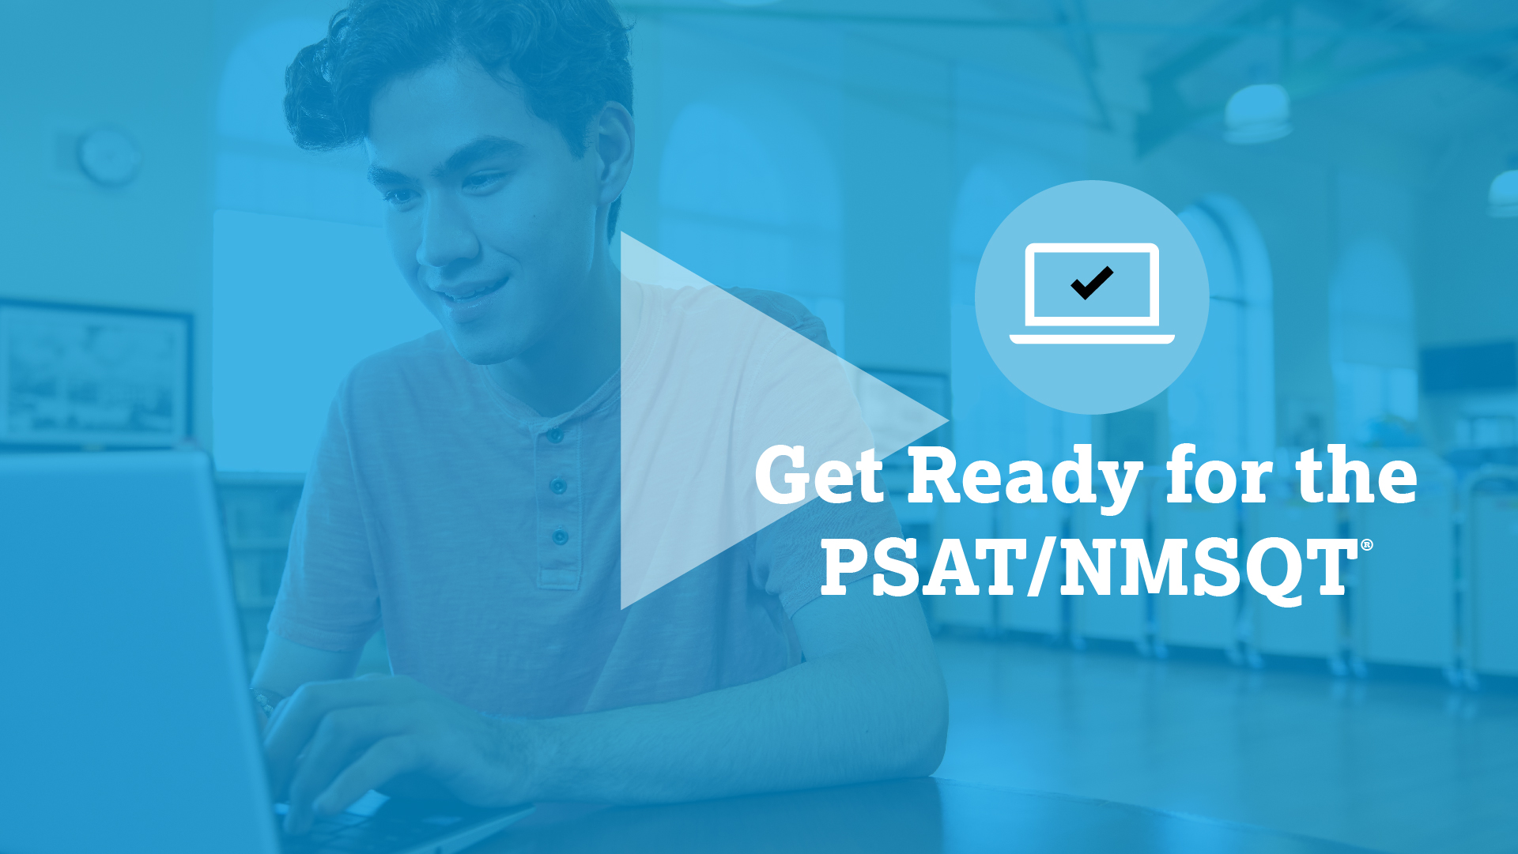
PSAT/NMSQT
What to Expect
Students preparing for the digital PSAT/NMSQT will have access to free, high-quality test preparation resources. Watch this video to learn more.
Notes:
Script template:​
Let’s watch this video to learn more.​

Slide 15
PSAT/NMSQT
Testing Details
Date: Thursday, October 12th
Time: 7:39 a.m. (no homeroom, students will go directly to testing classroom).
Location: Oxford Area High School
Format: Digital
Notes:
Note for educators: Please update this slide and the speaker notes with information specific to your PSAT/NMSQT administration.​
Script template:​
This year the PSAT/NMSQT will be given on [insert date] from [insert time range] at [insert location information]. [Mention any additional information].​
​

Slide 16
Thank You!
Notes:
Note for educators: Please customize the closing commentary based on your timeline to test day and preferred method of communication.​
Script template:​
Thank you all for your time today. We will continue to share more information as we get closer to test day. In the meantime, please reach out to us with any questions you have.

